Slide 1




Data Science Project
PREDICT LOAN STATUS WITH LOGISTIC REGRESSION
https://github.com/hardiantots/predictloanstatus_LogReg
Hardianto Tandi Seno
hardiantotandiseno@gmail.com

Slide 2




ABOUT PRESENTATION
Contains the creation of a classification model to predict a person's credit risk. Where credit risk status is divided into two classifications (Binary Classification) and viewed based on loan status (0 for "Charged Off", 1 for "Fully Paid"). The label in this dataset is in the "loan_status" column, because this column is the final determinant of whether a person's credit risk is low or high based on their loan status.

Slide 3

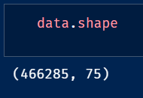

ABOUT DATASET
The dataset used is the loan dataset 2007-2014, with a total of 75 columns & 466.285 rows. Of course, not all columns will be used for the modeling process and data pre-processing will be carried out to ensure that the resulting model is accurate for predicting credit risk based on loan status.

Slide 4
DATA PRE-PROCESSING 1
DROP COLUMN WITH > 50% MISSING VALUE
DROP SOME UNNEEDED COLUMN
CHANGE LOAN STATUS FOR ONLY 2 CATEGORIES
SEPARATE DATA BASED ON CATEGORICAL & NUMERICAL
FILL NAN VALUE IN COLUMNS

Slide 5
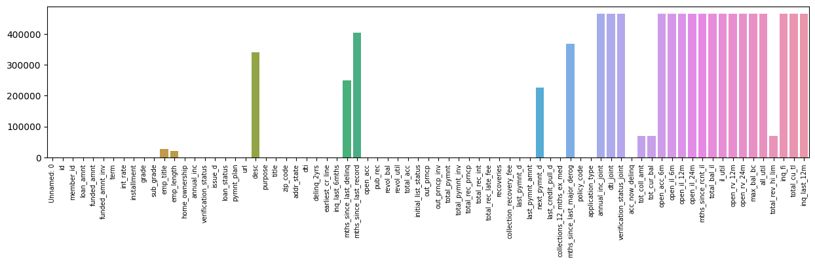
DATA PRE-PROCESSING 1
DROP COLUMN WITH > 50% MISSING VALUE
Here you can see a number of columns with missing values of more than 50%. The benefits of doing this are to improve data quality, simplify datasets, and can improve performance during data analysis and modeling

Slide 6
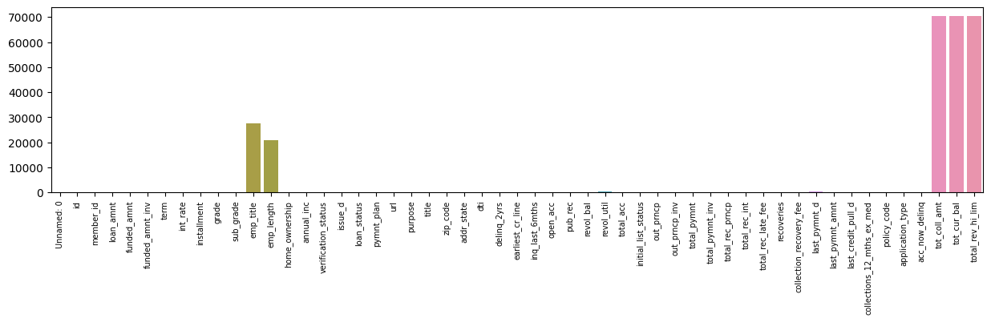
DATA PRE-PROCESSING 1
DROP COLUMN WITH > 50% MISSING VALUE
Here you can see the final column from the results of the drop missing value column, where quite a number of columns were dropped.

Slide 7
DATA PRE-PROCESSING 1
DROP SOME UNNEEDED COLUMN
The next step is to drop some unneeded column. This is done because there are several columns that will not play an important role in the modeling process later. The list of columns that are not needed are:
'UNNAMED: 0'
'ID'
'MEMBER_ID'
'FUNDED_AMNT'
'FUNDED_AMNT_INV'
'INT_RATE'
'SUB_GRADE'
'EMP_TITLE'
'issue_d'
'pymnt_plan'
'url'
'zip_code'
'OUT_PRNCP'
'OUT_PRNCP_INV'
'TOTAL_PYMNT'
'TOTAL_PYMNT_INV'
'TOTAL_REC_PRNCP'
'TOTAL_REC_INT'
'TOTAL_REC_LATE_FEE'
'RECOVERIES'
'COLLECTION_RECOVERY_FEE'
'LAST_PYMNT_D'
'LAST_PYMNT_AMNT'

Slide 8
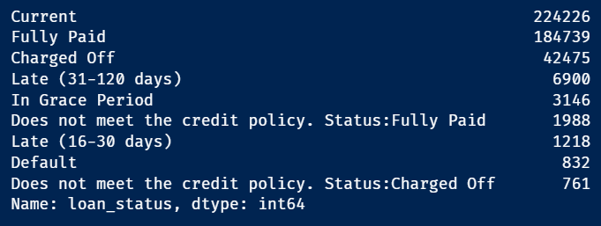
DATA PRE-PROCESSING 1
CHANGE LOAN STATUS FOR ONLY 2 CATEGORIES
The reason i change loan status for only 2 categories is because I see only 2 categories that can be a benchmark for whether a credit loan is accepted or not
The following is a list of loan statuses in the dataset. At this moment I only took 2 categories, namely "Fully Paid" & "Charged Off". The reason is that these 2 categories already have certainty regarding loan status and it is unlikely that any changes will occur

Slide 9
DATA PRE-PROCESSING 1
SEPARATE DATA BASED ON CATEGORICAL & NUMERICAL
The process of separating data based on categorical and numerical is useful when entering the data transformation process (encoding categorical data). Because we will find it easy to find out which column contains categorical data so that the encoding process can take place more quickly.
To see the complete process of separated data, you can look at the ipynb file in the repository

Slide 10
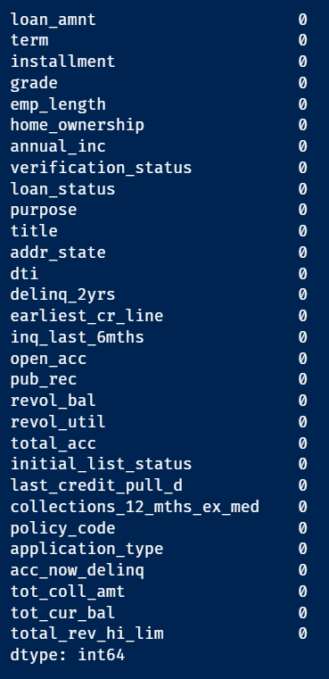
DATA PRE-PROCESSING 1
FILL NAN VALUE IN COLUMNS
For the fill nan value process, in numerical data, the fill process is carried out by giving the mean value of the column that contains the NaN value.
For categorical data, the fill process is carried out by changing the NaN value to the string 'unknown'.
In the picture beside, shows that there are no more NaN values in each existing column

Slide 11

EXPLORATORY
DATA ANALYSIS
USING POWER BI & SEABORN FOR VISUALIZATION DATA

Slide 12
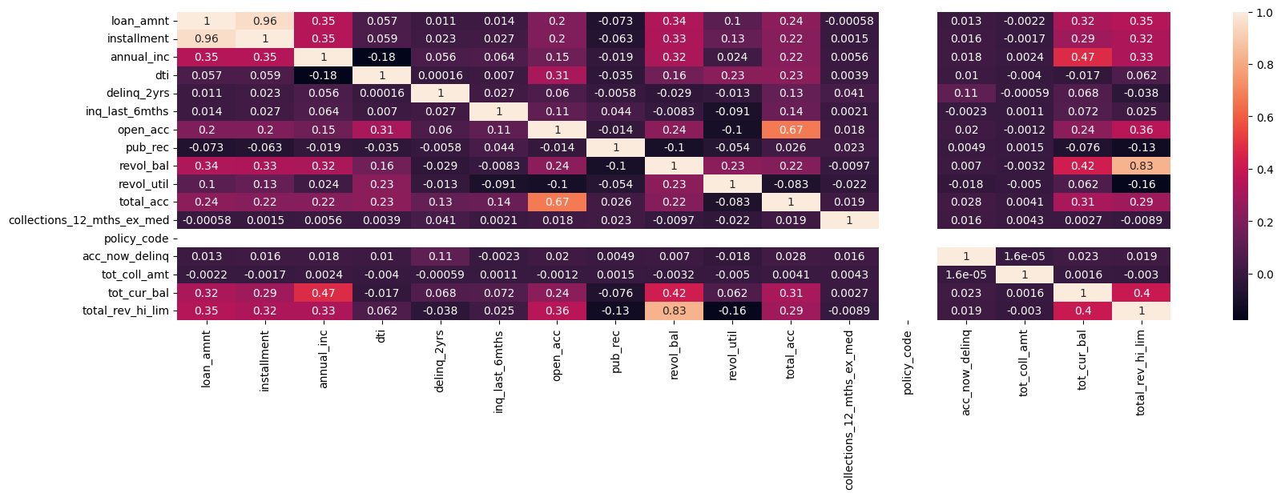

CORRELATION BETWEEN COLUMN USING SEABORN
(JUST NUMERICAL DATA)

Slide 13
THERE ARE 3 COLUMNS IN THE NUMERICAL DATA THAT HAVE A FAIRLY STRONG CORRELATION, NAMELY :
01
02
03
LOAN_AMNT & INSTALLMENT
REVOL_BAL &
TOTAL_REV_HI_LIM
TOTAL_ACC & OPEN ACC
The amount of the loan given & The monthly payment owed by the borrower
Total credit revolving balance & Total revolving high credit/credit limit
The total number of credit lines currently in the borrower's credit file & The number of open credit lines in the borrower's credit file.

Slide 14
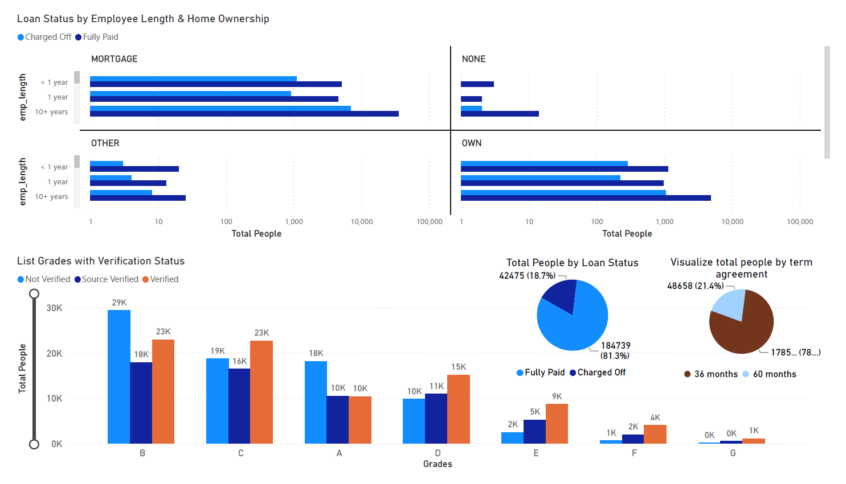

VISUALIZATION DATA ON POWER BI

Slide 15
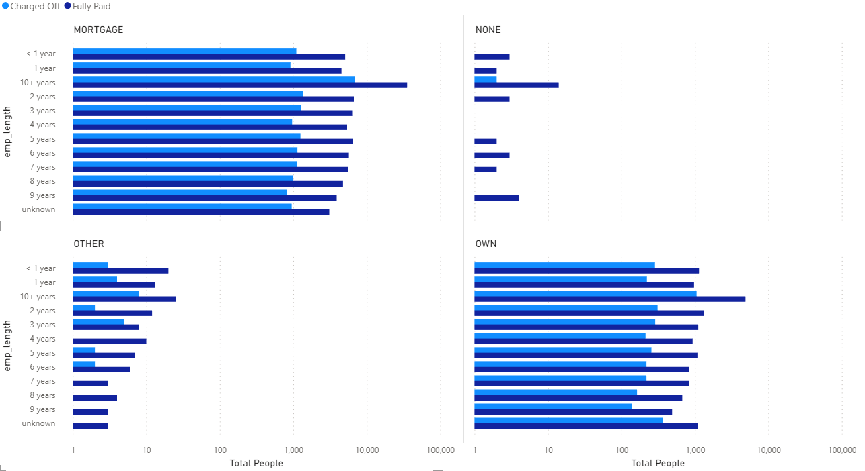
LOAN STATUS BY EMPLOYEE LENGTH & HOME OWNERSHIP

Slide 16
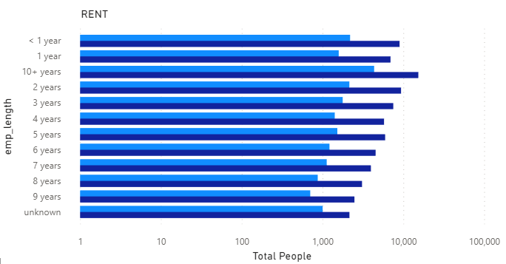
LOAN STATUS BY EMPLOYEE LENGTH & HOME OWNERSHIP
From the visualization of loan status based on length of work & home ownership, there are several summaries that we can put forward, such as:
The 3 categories of home ownership that most borrowers are "Mortgage", "Own", & "Rent"
In the chart of loan status based on employee length and home ownership, it can be seen that each category, both based on employee length (< 1 year - 10+ years) and based on home ownership, has almost the same graph, where most of the loan status is "Fully Paid", even though there are also quite a lot of loans with "Charged off" status.
Conclusion that can be drawn is that employee length and home ownership have less influence on loan status because they have similar tendencies.

Slide 17
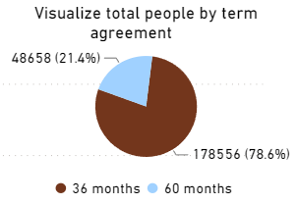
TOTAL PEOPLE BY TERM AGREEMENT
From this visualization, we can conclude that around 78.6% (178556) people agree to a term agreement of 36 months and around 21.4% (48658) of people agree to a term agreement of 64 months.

Slide 18
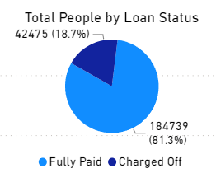
TOTAL PEOPLE BY LOAN STATUS
From this visualization it can be concluded that around 81.3% (184739) people have a loan status "Fully Paid" or have paid off a loan and around 18.7% (42475) people have a loan status "Charged Off" or the borrower is unable to repay the loan so that it is considered a loss for the lender.

Slide 19
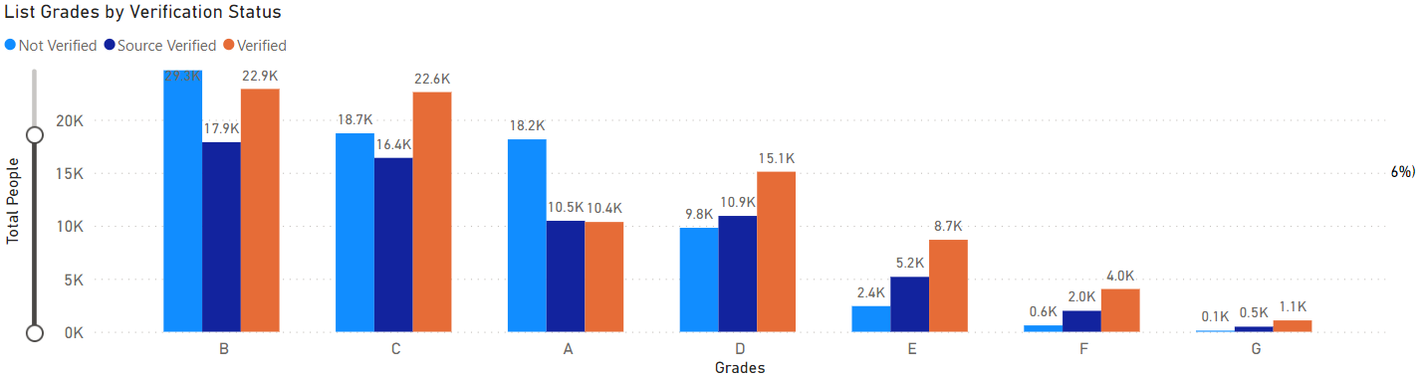
LIST GRADES BY VERIFICATION STATUS
Grade when applying for a loan shows the range of loans applied for. From the existing graph, it can be seen that grade B is the grade with the most borrowers, followed by grade C & grade A. This means that the average range of loans proposed is quite high. Verification status is very important to ensure that the lender gives the option not to submit any collateral for the loan to the right borrower.
Then from these grades, it can be seen that the 3 highest grades, there are still many verification status "Not Verified".
- In Grade B, "Not Verified" status verification dominates, although "Verified" status is also high. For "Source Verified" status, it is the lowest among the three categories.
- In Grade C, it has the reverse condition with Grade B, where "Verified" has the most status followed by "Not Verified".
- In Grade A, the conditions are almost the same as Grade B, but the distance between "Not Verified" status & "Verified" status is quite far.
- For the order of 4 and so on, it can be seen that "Verified" status is the most among the others.

Slide 20
DATA PRE-PROCESSING 2
CLEAR OUTLIER
TRANSFORMATION DATA
CHOOSE FEATURE & TARGET
SET TRAINING & TEST SET FROM DATA

Slide 21
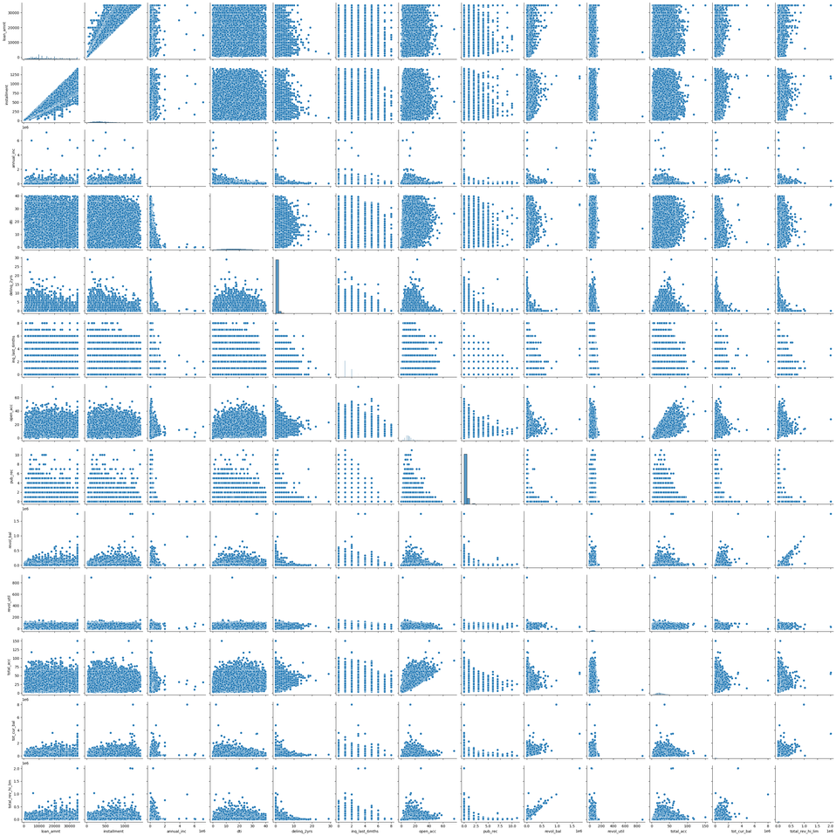
DATA PRE-PROCESSING 2
CLEAR OUTLIER
First, we have to visualize the data (only numeric data, because categorical data cannot be visualized before starting the encoding operation) to see the outliers in each column.
For a more detailed visualization, you can see the ipynb file in the repository because the image width is very large.

Slide 22
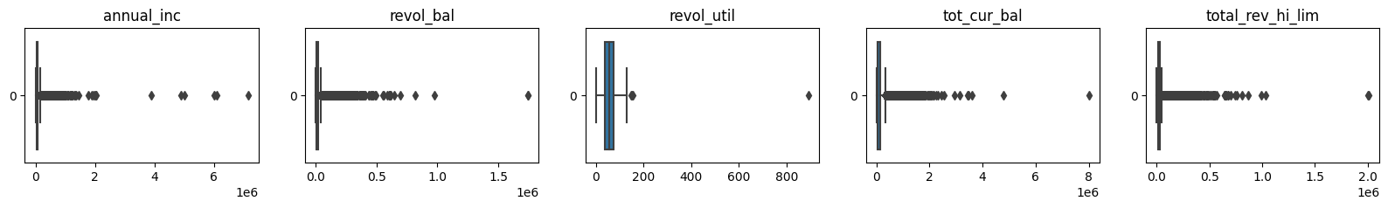
DATA PRE-PROCESSING 2
CLEAR OUTLIER
We can directly perform operations on certain columns (the range of values on the chart is the same as those in the column) that have outliers by performing a comparison operation, then the value of the operation is updated in the selected column.
For a range of values on the chart that are not the same as those in the column, we can see further outliers with boxplots

Slide 23
DATA PRE-PROCESSING 2
CLEAR OUTLIER
There are still 5 columns whose outliers will be removed, what can be done is by applying the IQR (Interquartile Range). Using the IQR method, outliers that are well below or above the typical range of values in a data set can be detected and potentially removed.

Slide 24
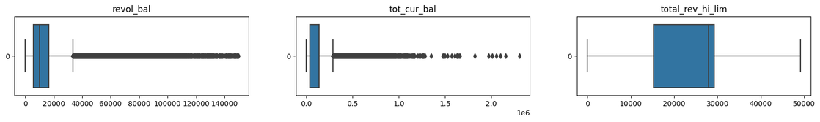
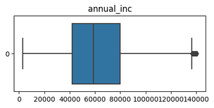
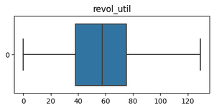
DATA PRE-PROCESSING 2
CLEAR OUTLIER
The following is the boxplot after removing the outliers in the five columns:
After the process of removing outliers is carried out, there is a reduction in the data that was:
227.214 rows of data to 196.415 rows of data

Slide 25

DATA PRE-PROCESSING 2
TRANSFORMATION DATA
After cleaning the outliers, the next step is to perform data transformation, where the numerical data will be normalized for better modelling (using MinMaxScaler) and the categorical data will be encoded to change the data in the column into numbers (using LabelEncoder).
To do this transformation, can use scikit-learn library

Slide 26
DATA PRE-PROCESSING 2
CHOOSE FEATURE & TARGET
After that, we must choose feature column & target column for modelling process later.
Featue Columns : All columns without a loan status column
Target Column : Just loan status column

Slide 27
DATA PRE-PROCESSING 2
SET TRAINING & TEST SET FROM DATA
Set training & test set from data with using scikit-learn library with :
Test set data set to 0.2 (20%)
Training set data set to 0.8 (80%)

Slide 28



MODELLING PROCESS
MODEL THAT USED
EVALUATION METRICS
SAVE MODEL
Model that will used for this scenario
Evaluate model performance using some metrics like precision, recall, f1-score, and ROC Curve
Model can be save for using in application that need this model

Slide 29

MODELLING PROCESS
MODEL THAT USED
Model that will used for this scenario is Logistic Regression (Classfication Model). Logistic regression is a data analysis technique that uses mathematics to find the relationship between two data factors. It then uses this relationship to predict the value of one of these factors based on the other factors.

Slide 30
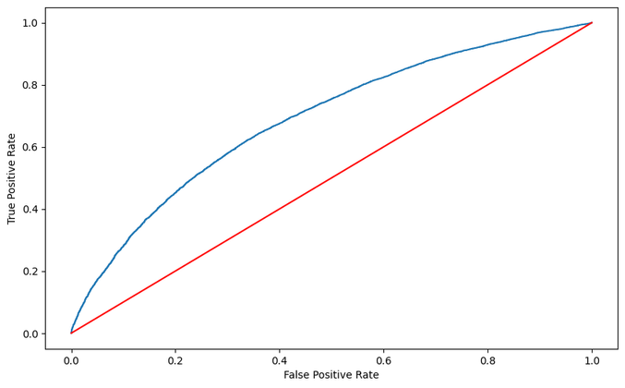
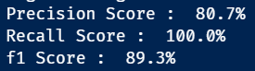
MODELLING PROCESS
EVALUATION METRICS
Result of ROC Curve :
Evaluate model performance using some metrics like precision, recall, f1-score, and ROC Curve.
Result of Precision, Recall, & f1 Score from model
*Conclusion for detailed information about evaluation

Slide 31

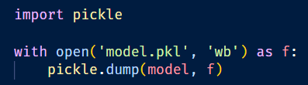
MODELLING PROCESS
SAVE MODEL
Model can be save for using in application that need this model. We can save the model with using library called Pickle.

Slide 32
CONCLUSION
The purpose of this project is to predict the loan status of prospective borrowers so that lenders can find out the eligibility status of granting loans.
Many columns in the dataset are dropped, either because there are many missing values in these columns or these columns are less useful for the process of extracting information later.
From the existing dataset, it turns out that more than 70% of the loan status is "Fully Paid"
In this project, two data pre-processing and one Exploratory Data Analysis (EDA) were carried out. For the EDA process itself, a more in-depth analysis can still be carried out regarding the relationships in the column.
The modeling process uses the Logistic Regression model, because it uses mathematics to find the relationship between two data factors. It then uses this relationship to predict the value of one factor based on the other factor. I feel this model is suitable to be applied in this case.
In the evaluation metrics section, I feel that the performance of this model can still be improved, this is because no processing has been carried out on categorical data (such as removing outliers, etc.). Besides that, I haven't used hyperparameter tuning (using GridSearchCV) which can be used to find the best parameters for the modeling process.

Slide 33



THAT'S ALL FROM ME
THANK YOU
LINKEDIN
Hardianto Tandi Seno
E-MAIL
hardiantotandiseno@gmail.com

